Slide 1
COVID-19 Pandemic impacts on unemployment
DATA 512-Human Centered Data Science
Lan Luan

Slide 2
Question1:
Does the Covid-19 pandemic affect the unemployment rate?

Slide 3
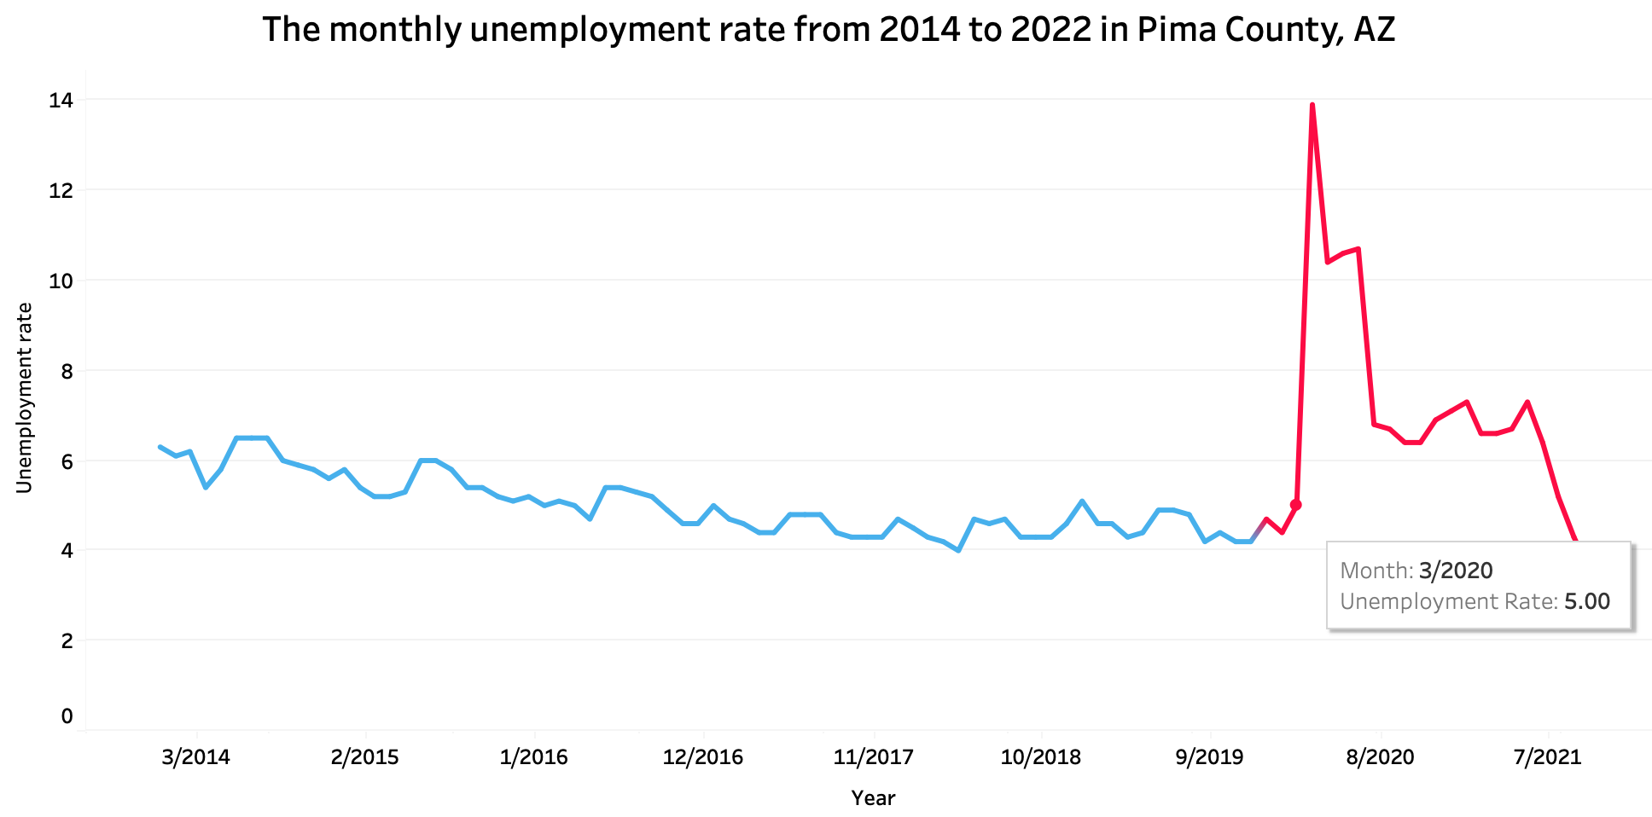
Exploratory data analysis
Interesting Findings
Unemployment rate has increased dramatically since the pandemic began
With 13.9 unemployment rate in Pima County, AZ, it reaches its peak in April 2020
Unemployment rate discontinuity drops as the covid-19 endures

Slide 4
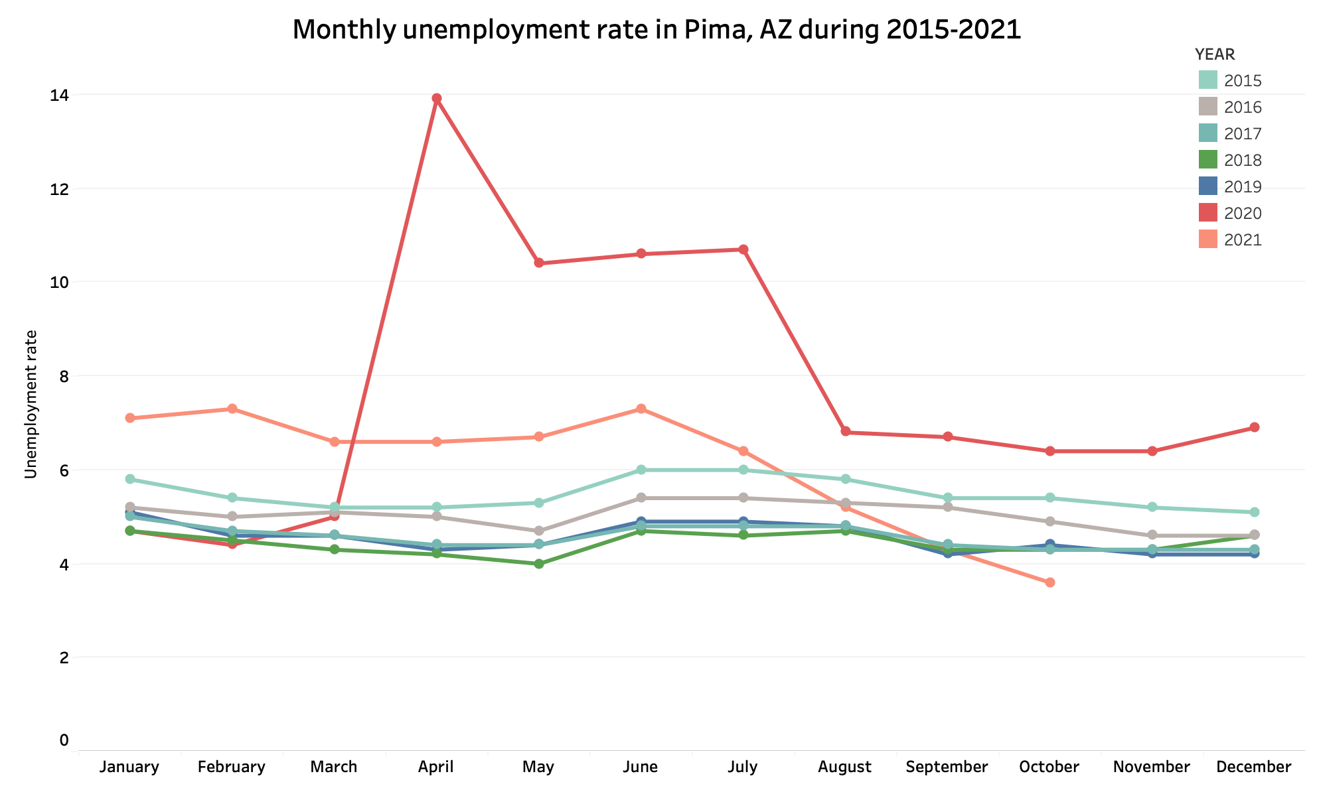
Exploratory data analysis
Interesting Findings
The monthly unemployment rate in Pima, Arizona fluctuated significantly in 2020 and 2021
In comparison with other years, the unemployment rate does not fluctuate greatly from month to month

Slide 5
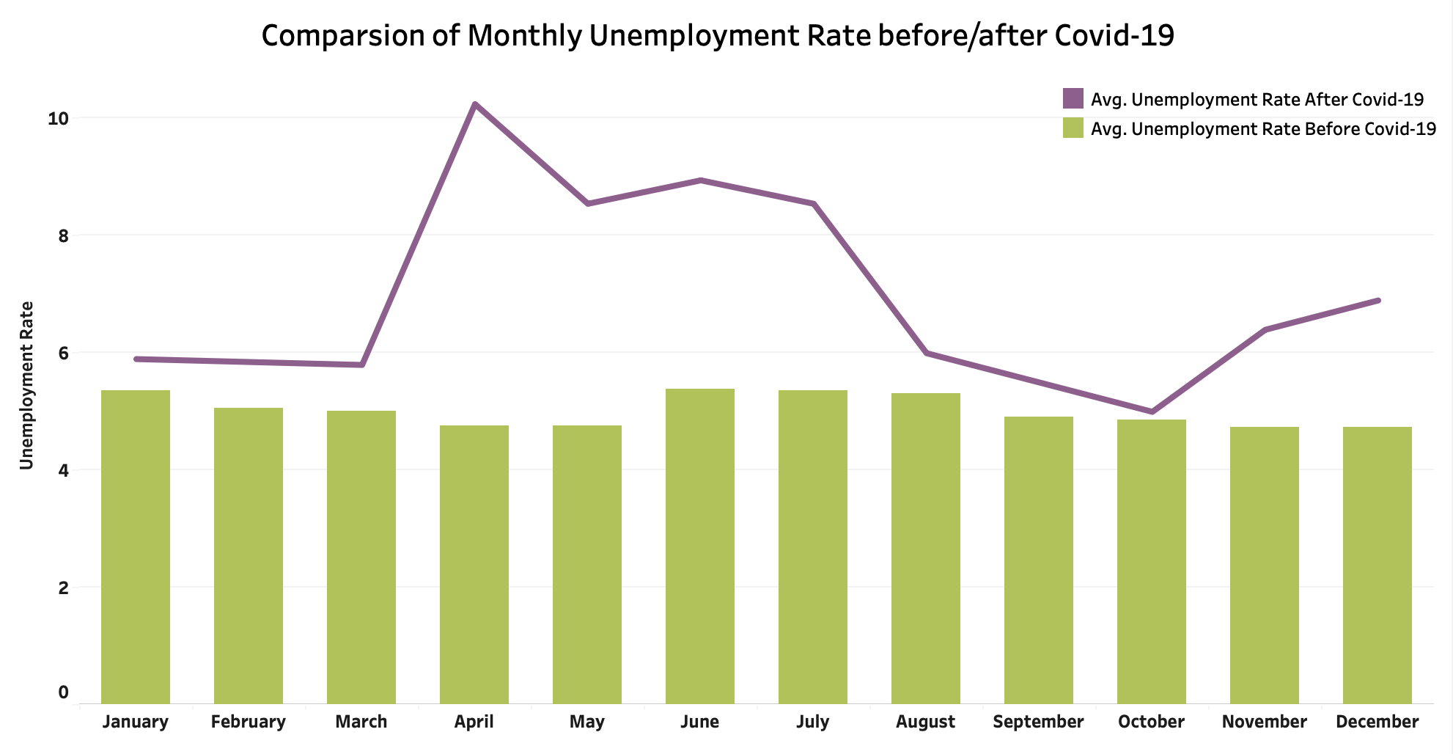
Exploratory data analysis
Interesting findings
Before Covid-19, the average monthly unemployment rate was stable
The average monthly unemployment rate has gone up and down since the pandemic

Slide 6
Null Hypothesis
Prior to and after the pandemic, the monthly unemployment rate remained the same.
μ1 = μ2
Where μ1 and μ2 represents the monthly unemployment rate before and after Covid-19 pandemic, respectively.

Slide 7
Hypothesis Testing
Methodology: Welch Test (Unequal variance t-test)
Assumptions: Independence, Normality, Small Sample Sizes
Outcome:
T-Statistic = 4.4825
P-Value = 0.000214
Mean of monthly unemployment rate before Covid-19 = 4.813
Mean of monthly unemployment rate after Covid-19 = 7.162
Result:
P-value < 0.05 enough evidence to reject the Null Hypothesis of equal means.

Slide 8
Question 2:
Is there a linear relationship between the unemployment rate and the infected number?

Slide 9
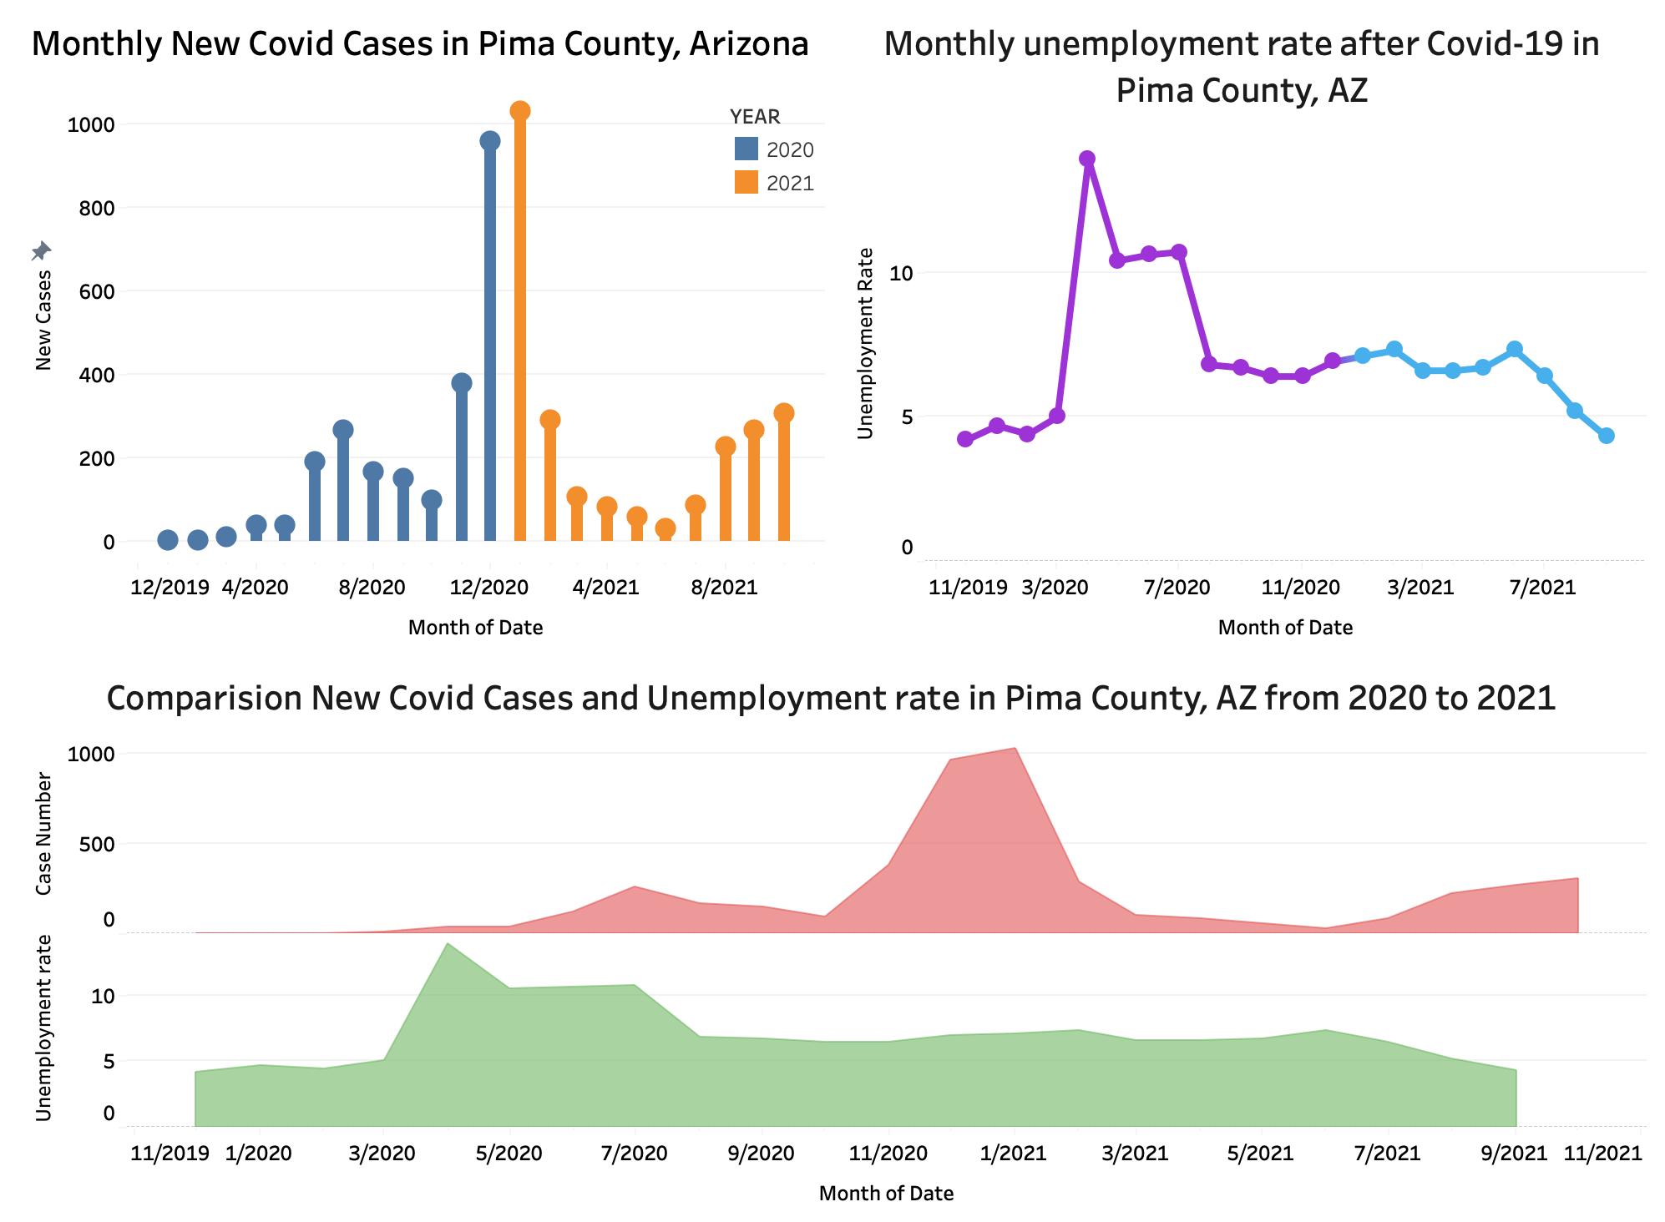
Exploratory data analysis

Slide 10
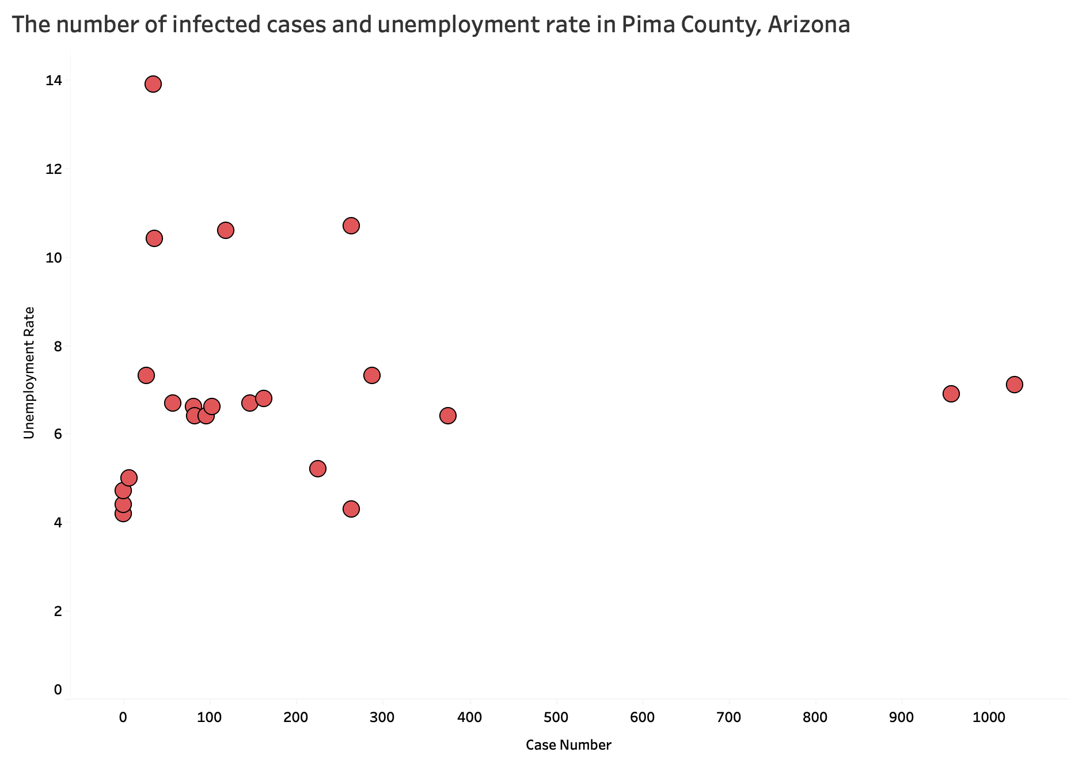
Exploratory data analysis
Number of infected cases does not linearly correlate with unemployment rate

Slide 11
Results & Conclusions
There is a significant difference between the unemployment rates before and after the Covid-19 pandemic, according to the null hypothesis test
Unemployment rate has been severely affected by the pandemic
There is no correlation between the unemployment rate and the number of infected people

Slide 12
Questions?

